Slide 1



Introduction to GitHub Copilot
Lessons Learned from GitHub Copilot Adoption
Exploring AI assistance in coding workflows
by RocketMind academy
Notes:
AI-generated content may be incorrect. --- GitHub Copilot is an AI-powered code completion tool that assists developers by suggesting code snippets and entire functions. In this presentation, we will explore its features, benefits, integration with development environments, and how to get started with it.

Slide 2
01
Key Findings

Slide 3

Productivity Gains Over Time
Early-Stage Productivity Gains
Early-stage implementations show an average productivity improvement of 6%, with a range from 1.7% to 10.6%.
Mature Implementation Gains
Mature implementations achieve an average productivity improvement of 14.62%, ranging from 10.6% to 19.29%.
Factors Influencing Success
Success factors include experienced senior developers, focused projects, and regular reporting practices.

Slide 4
02
Critical Lessons Learned

Slide 5

Success Factors and Challenges
Success Factors
Identifying key success factors like repetitive task automation, senior developer involvement, and training is crucial for effective AI implementation.
Challenges Faced
Understanding challenges such as complex bugs, junior developers' reliance on AI, and reporting gaps helps in improving the process.
Importance of Training
Proper training in AI usage is essential for maximizing benefits and ensuring effective oversight, especially for junior developers.

Slide 6
03
Best Practices

Slide 7
Maximizing Copilot's Value
Focus on Repetitive Tasks
Utilize Copilot for repetitive tasks such as scaffolding, tests, and documentation to enhance productivity.
Train Developers
Educate your team on prompt engineering and context-aware usage to maximize the effectiveness of Copilot.
Leverage Prompt Files
Create and use reusable templates to streamline common tasks like building React forms and conducting security reviews.
Combine with Tools
Integrate Copilot with CI/CD pipelines, linters, and version control systems for a seamless development process.
Ethical & Quality Safeguards
Always review AI-generated code for errors and compliance to ensure quality and adherence to standards.

Slide 8
04
Implementation Strategies

Slide 9
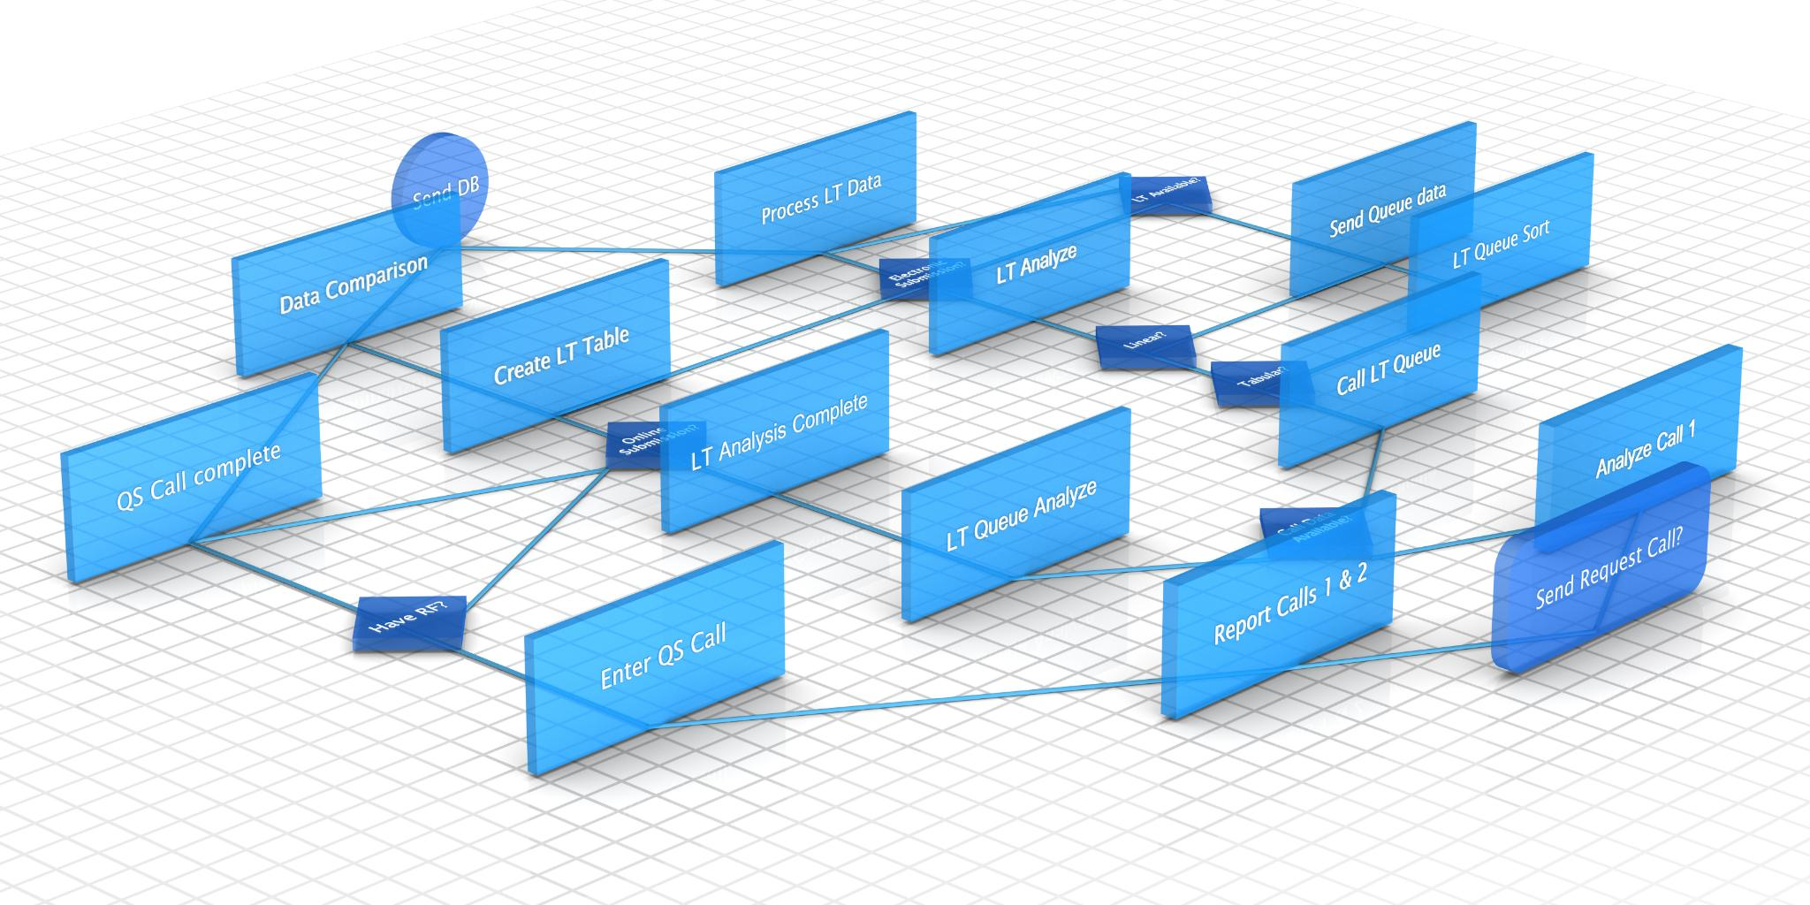
Adopting Copilot in Teams
Start Small
Begin by piloting GitHub Copilot with senior developers on non-critical tasks to gather initial feedback and insights.
Customize Instructions
Establish coding standards with a dedicated instructions file to ensure consistency across the team when using Copilot.
Track Metrics
Measure time savings, code quality, and bug rates to assess the effectiveness of Copilot in development tasks.
Iterate
Use feedback from the team to refine prompts and workflows, improving the integration of Copilot in development processes.

Slide 10
05
Limitations & Risks

Slide 11

When Copilot Falls Short
Code Quality Concerns
AI tools may compromise code readability for speed, making manual review essential to ensure quality.
Security and Ethical Risks
Using AI can lead to security vulnerabilities or the unintentional copying of proprietary code.
Over-Reliance on AI
Junior developers may become overly dependent on AI, neglecting to learn fundamental programming skills.
Cost-Benefit Analysis
The return on investment from AI tools varies based on specific use cases, impacting decision-making.

Slide 12
06
Future Recommendations

Slide 13

Next Steps for Teams
Expand Use Cases
Consider using Copilot Chat for tasks like debugging, documentation, and API integration to enhance team efficiency.
Standardize Prompt Engineering
Implement standardized templates to ensure consistent outputs across the team, such as in commit messages and PR descriptions.
Establish Ethical Guidelines
Create policies focused on code ownership, transparency, and bias mitigation to promote responsible AI usage in teams.
Integration with Tools
Combine AI tools with platforms like GitHub Actions and Jira to create seamless end-to-end workflows for project management.

Slide 14
07
Conclusion

Slide 15

Key Takeaways and Final Thoughts
GitHub Copilot as a Tool
Copilot serves as a collaborative tool that assists developers rather than replacing them in their work.
Importance of Training
Successful implementation of Copilot relies heavily on proper training and contextual customization for developers.
Task Alignment
Task alignment is crucial for ensuring that Copilot effectively meets the needs of development teams.

